Slide 1
Project Screenshot
By Amit Rustagi
Github link: https://github.com/arustagi06/Phase-1-LockedMe-Project

Slide 2
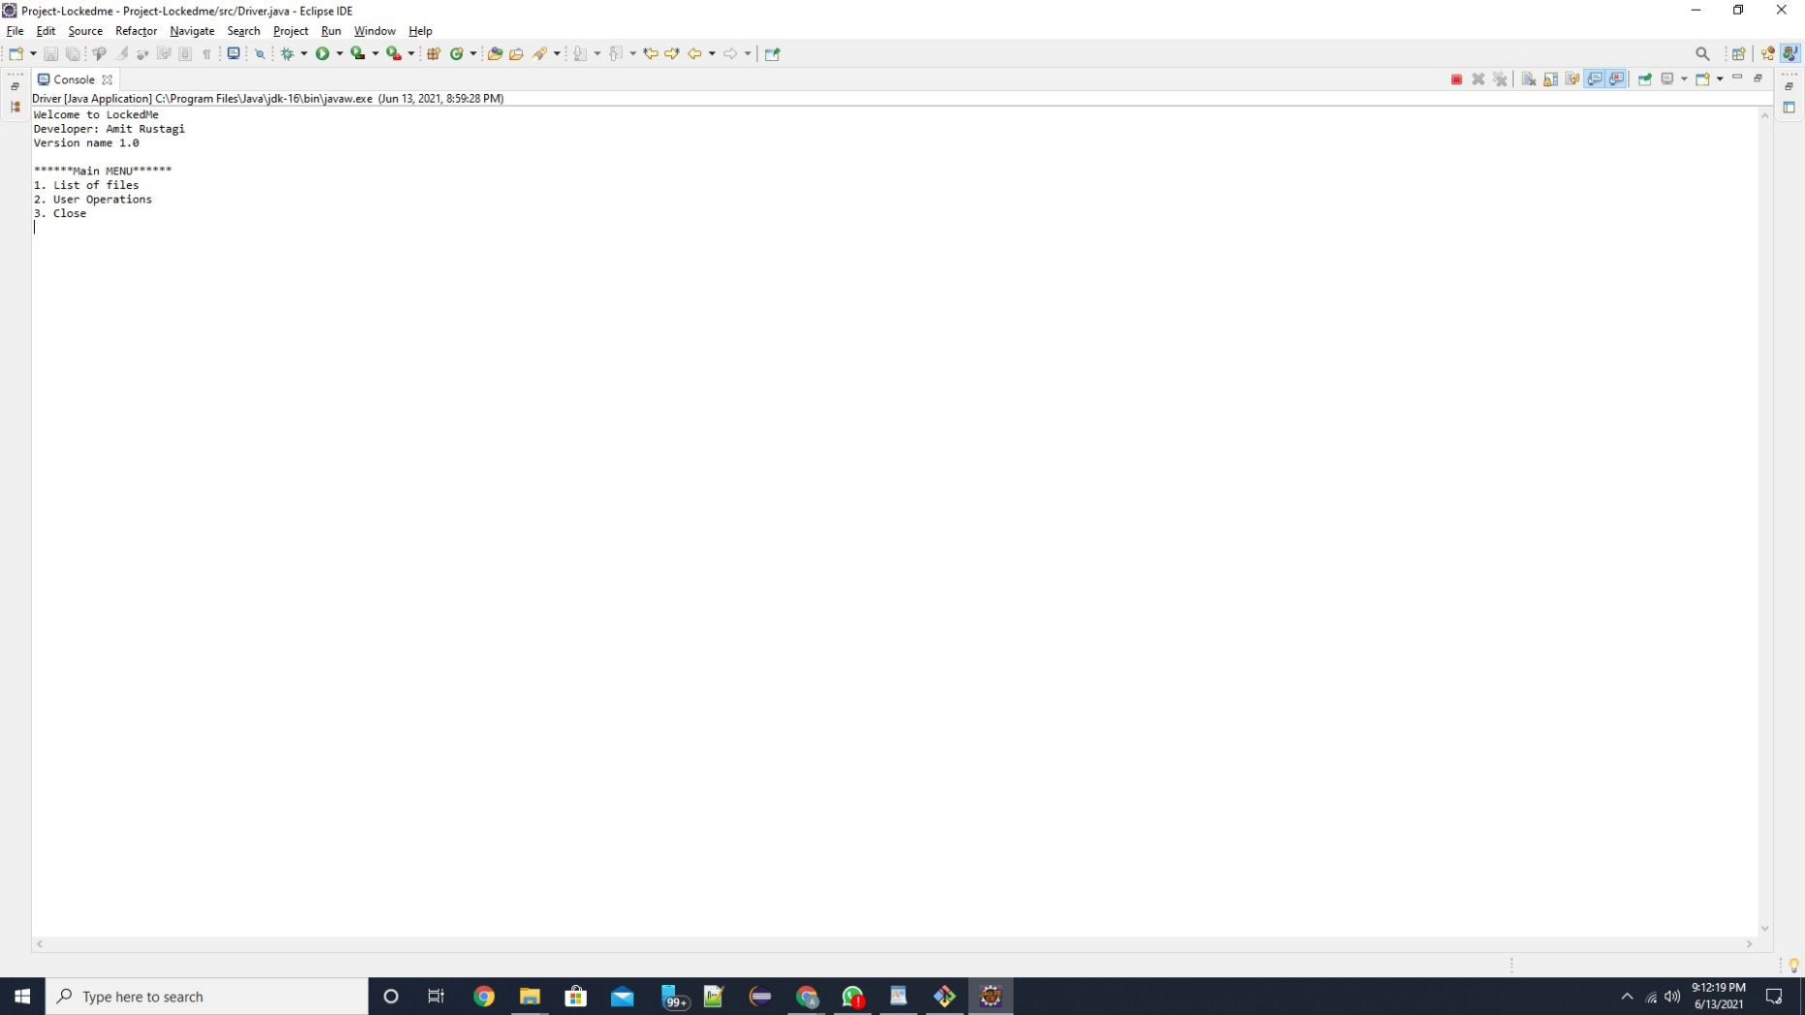
Welcome Screen

Slide 3
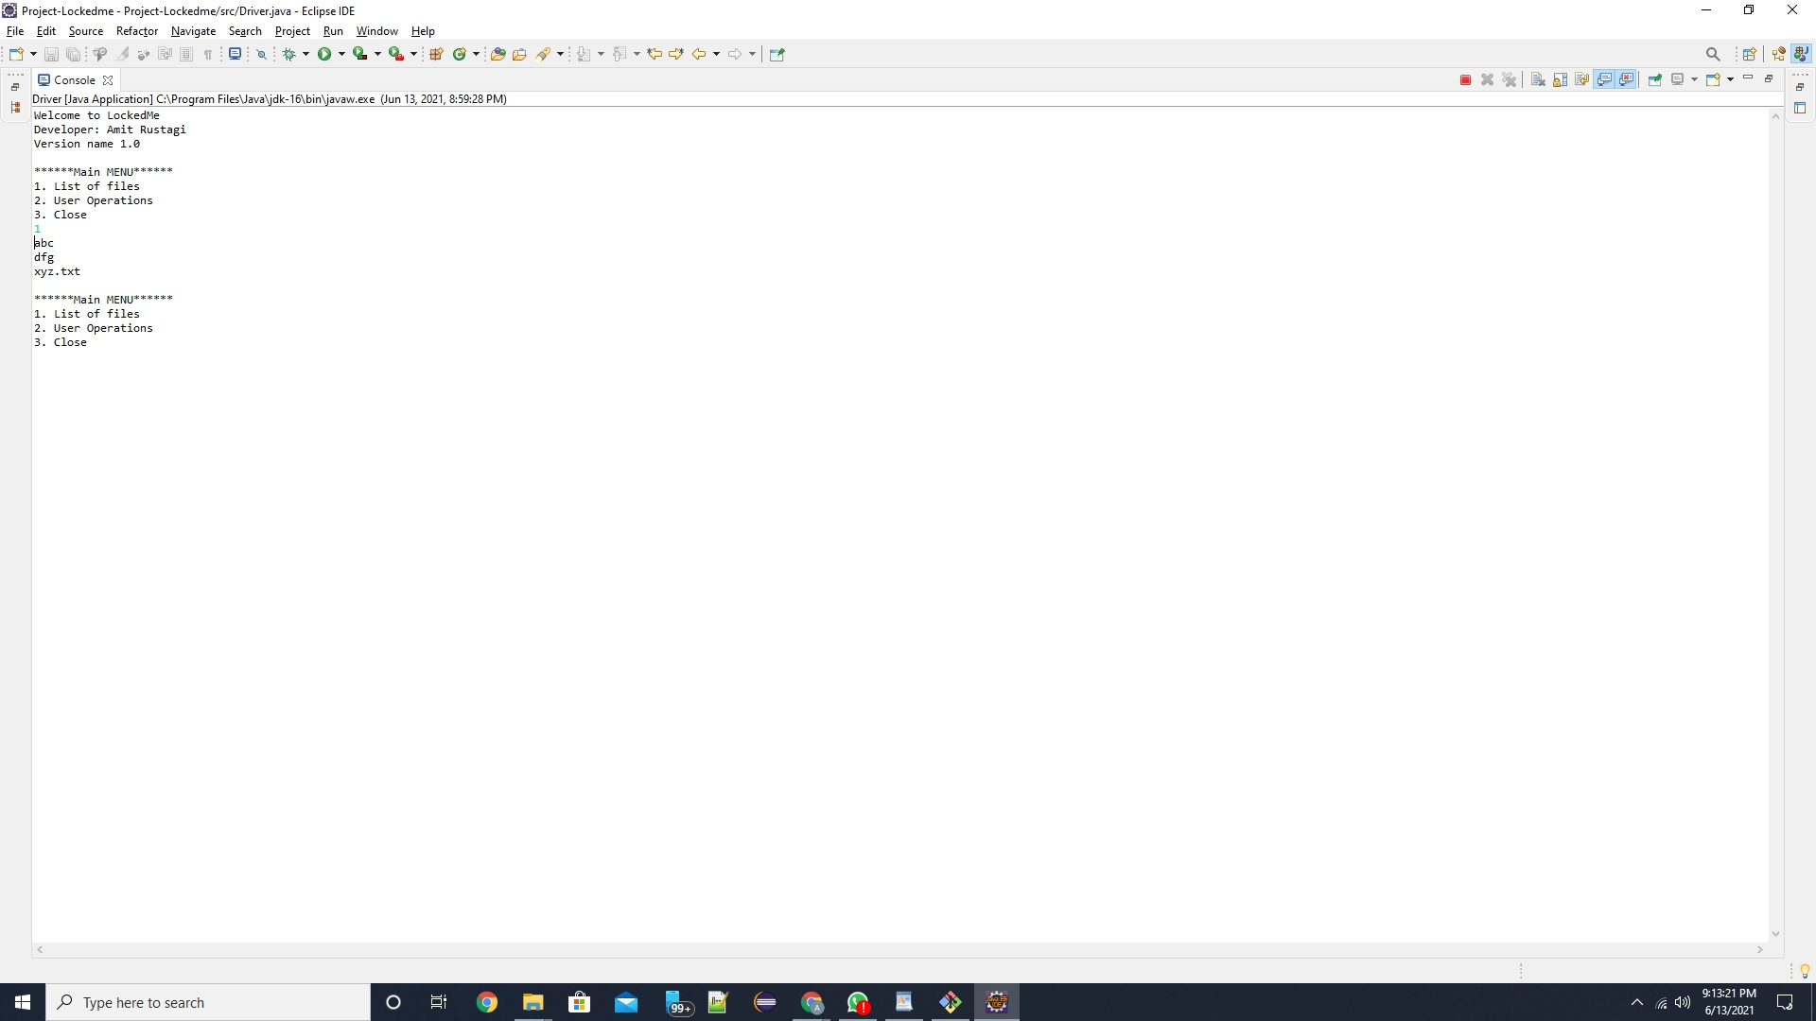
List Files in Ascending order

Slide 4
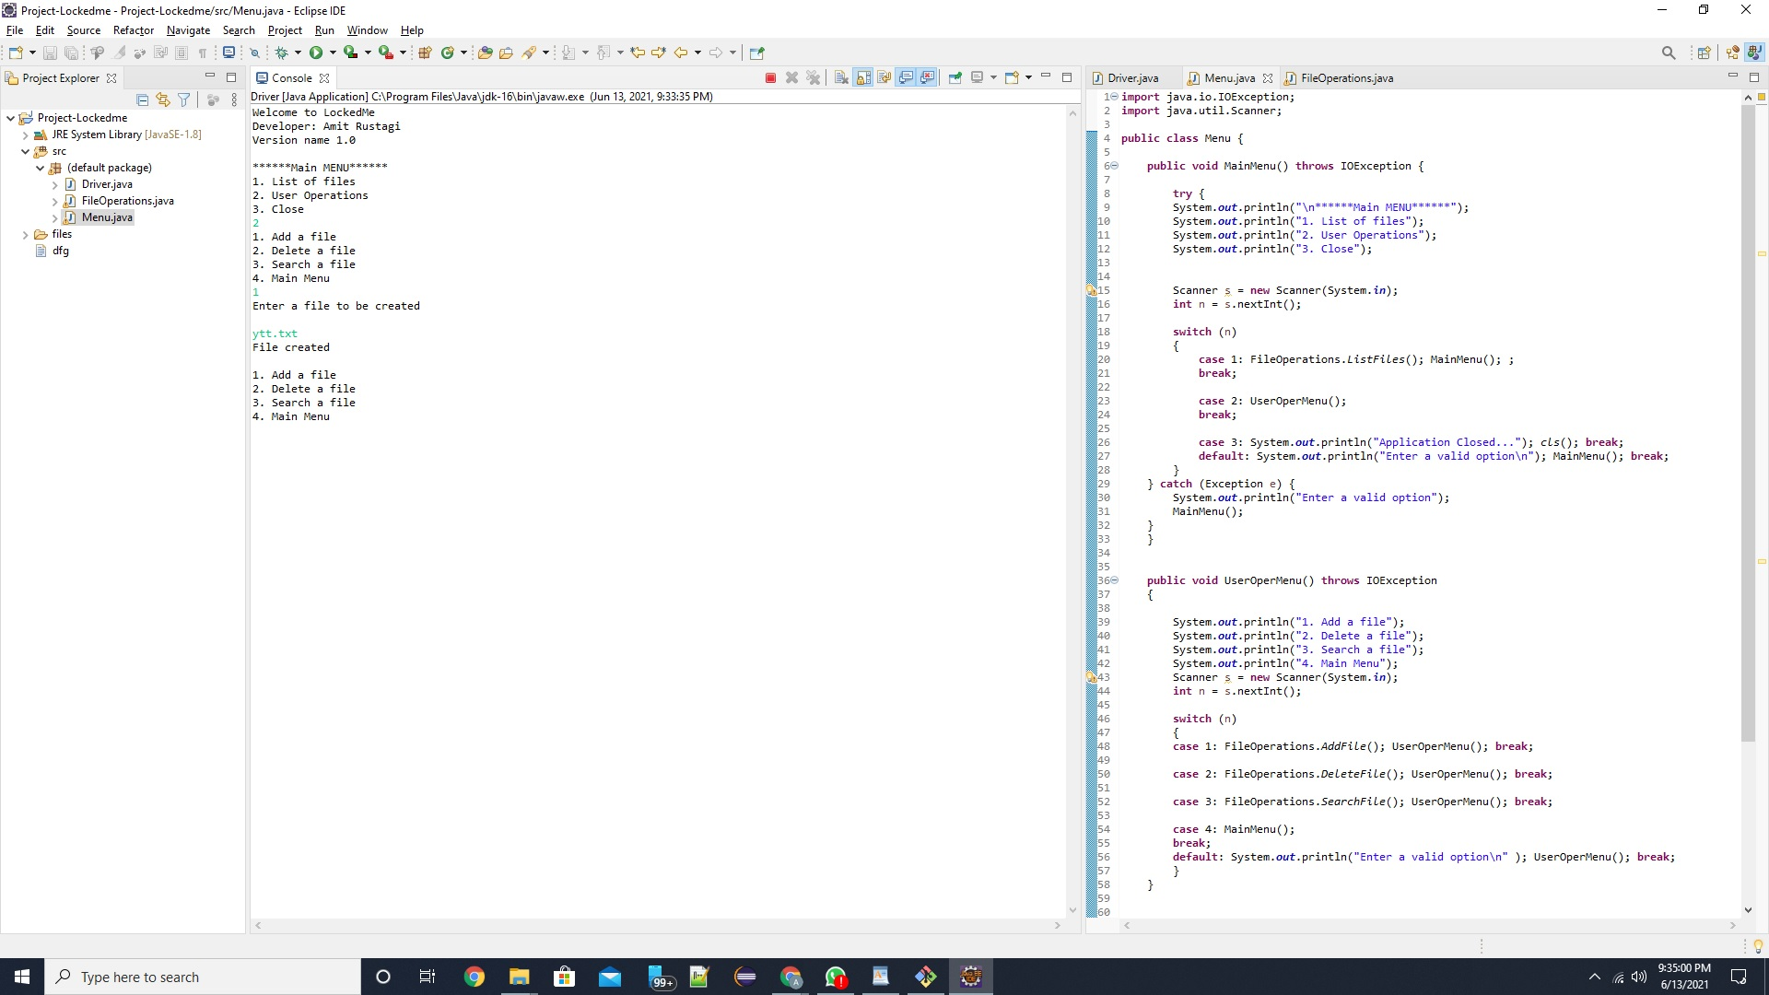
2.1 Option User operation AddFile

Slide 5

2.2 Delete a file

Slide 6
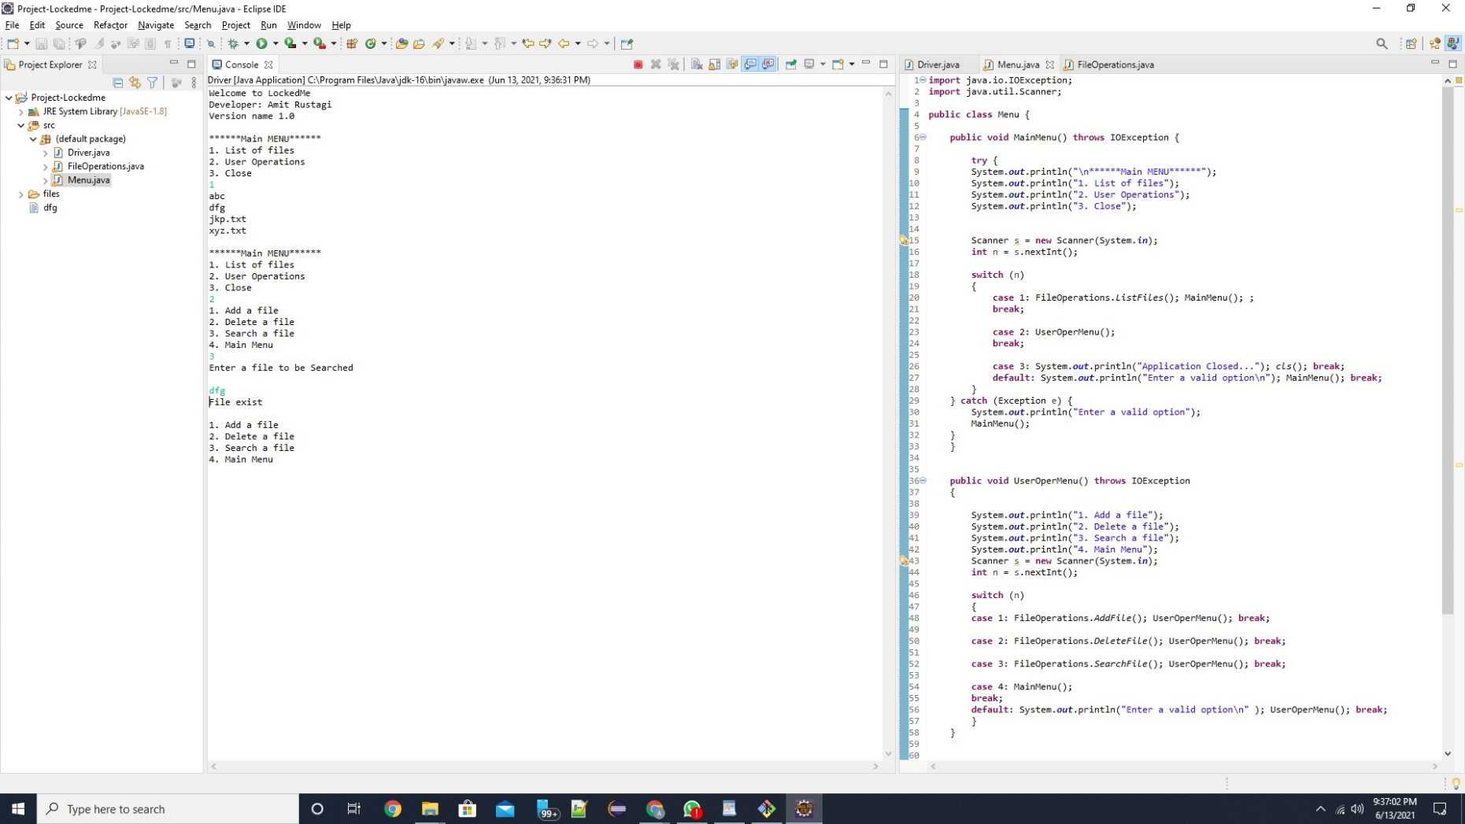
2.3 Search a file

Slide 7

2.4 Back to Main Menu

Slide 8

Exception handling

Slide 9

Closing the application

